Slide 1
News Summarization: AI-powered Insights
Team name : trouble shooters
Team members :
shafayet Hossain → C201121
Rabi al hasan → C201113
Mohammad Ammar Hossain → C201109
Kakon kumar dhar → C201114

Slide 2

Introduction
The ability to quickly and accurately summarize news articles is becoming increasingly important in today's fast-paced world. With so much information available at our fingertips, it can be overwhelming to sift through all the noise and find the most relevant and important information. This is where AI-powered news article summarization comes in.
Using Python and various machine learning techniques, we can train algorithms to automatically summarize news articles, saving time and increasing efficiency for both individuals and organizations.

Slide 3

The Problem
Manually summarizing news articles is a time-consuming and often tedious process. It requires reading through large amounts of text, identifying the key points, and then condensing them into a shorter summary. This can lead to inconsistencies in the quality and accuracy of the summaries produced, as well as delays in getting the information out to those who need it.
AI-powered news article summarization solves these problems by automating the process. By using natural language processing and other machine learning techniques, algorithms can quickly identify the most important information in an article and generate a concise summary, all without human intervention.

Slide 4
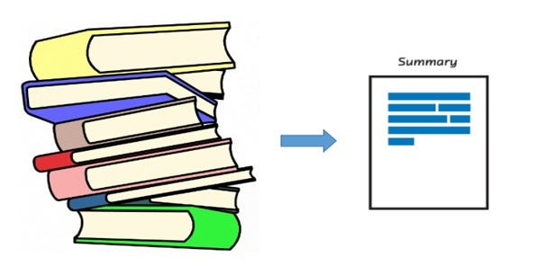
The Solution
Python is a popular programming language for implementing AI-powered news article summarization. There are several techniques and algorithms that can be used to accomplish this task, including text rank, latent semantic analysis, and neural networks.
Text rank is a graph-based algorithm that ranks the sentences in an article based on their importance. Latent semantic analysis uses singular value decomposition to identify the underlying concepts in the text and generate a summary based on those concepts. Neural networks can be used to train models to generate summaries based on examples of human-written summaries.

Slide 5
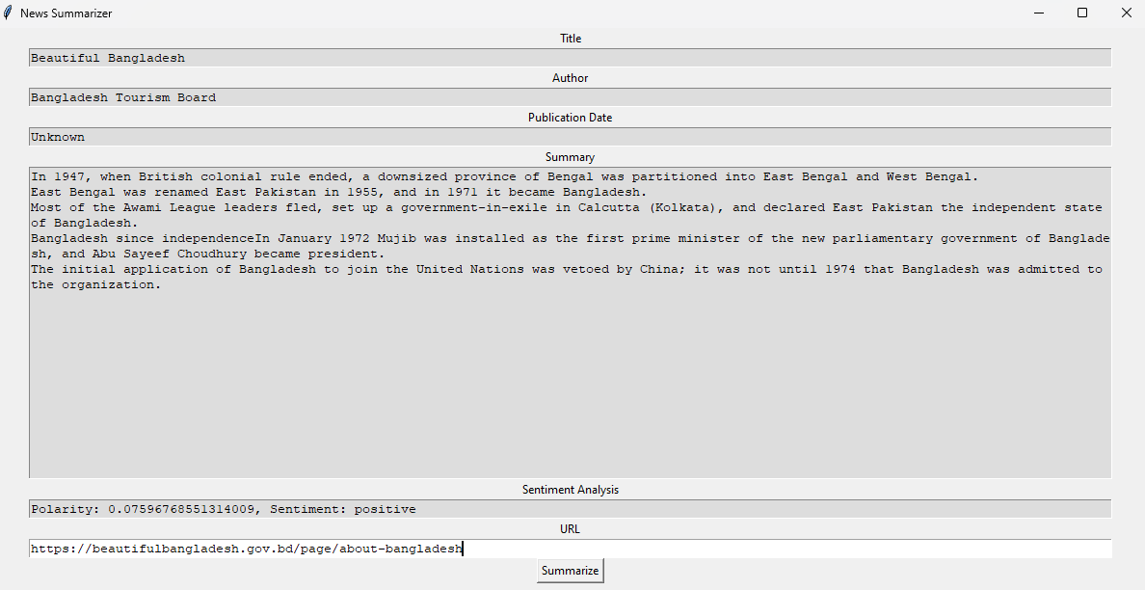
Overview of the Application
Features:
Extracts news articles from a given URL
Performs text summarization
Displays key information about the article and sentiment analysis

Slide 6
Things we used
Libraries Used:
Tkinter : A standard library in Python used for creating GUI applications.
Textblob : A library for natural language processing tasks, including sentiment analysis, part-of-speech tagging, and more.
Newspaper : A library for extracting and parsing articles from news websites, providing functionality for downloading, parsing, and extracting relevant information.
Graphical User Interface (GUI):
The GUI is created using the tkinter library, which provides tools for building GUI applications.
Various GUI elements are utilized, such as labels (tk.Label), text fields (tk.Text), and buttons (tk.Button).
The GUI allows users to input a news article URL and displays the article's information, summary, and sentiment analysis results.

Slide 7

Benefits
The benefits of using AI-powered news article summarization are numerous. First and foremost, it saves time by automating a previously manual process. This allows individuals and organizations to quickly get the information they need without having to spend hours reading through articles.
In addition to increased efficiency, AI-powered summarization also improves accuracy and consistency. Algorithms are able to identify the most important information in an article regardless of personal biases or preferences, leading to more objective and reliable summaries.

Slide 8

Applications
AI-powered news article summarization has applications in a wide range of industries. In journalism, it can be used to quickly provide breaking news updates or generate summaries of longer articles for busy readers. In finance, it can be used to analyze market trends and summarize financial reports. In marketing, it can be used to monitor brand mentions and summarize customer feedback.
The possibilities are endless, and as AI technology continues to advance, we can expect to see even more innovative applications of news article summarization in the future.

Slide 9

Conclusion
In conclusion, AI-powered news article summarization is an important tool for navigating the vast amount of information available today. By automating the process of summarizing news articles, we can save time, increase efficiency, and improve accuracy and consistency.

Slide 10


